Slide 1

Supervisor：Dr. Grace U. Nneji Reporter: Li.Taoyu
Chinese License Pl﻿ate Generation and Recognition System

Slide 2


Content
A
Introduction/Abstract
Dataset
Model
Evaluation Criteriav
Result

Slide 3
Introduction:
Abstract:
CLPGRS face huge challenges in the real world. License plates vary in size, font,
and color, and the quality of license plate images is often poor due to slanted
shooting angles, uneven lighting, occlusion, and blurring, and new plates
begin to need to be monitored.
Due to the frequent occurrence of motorcycle accidents and the gradual government regulation of electric motorcycles, the new motorcycle license plate recognition system is required to recognize the license plate of both traditional vehicles and motorcycles. Therefore, this project uses yolov-5+LeNet+CRNN model to make a new license plate recognition system.

Slide 4
Aim
The main goal of the project is to develop a prototype system capable of generating common license plates and simulating various situations while recognizing them even when they are dark or tilted. And users can enter pictures or videos from which the system can look up license plates. Users can enter various types of license plates, especially the ELM type. Once entered, the system will outline the location of the license plate and display the number next to it. If a user enters a video, all license plates will be dynamically marked and identified in the video.

Slide 5

The target object to which this project are oriented
CLPGR System

Slide 6
Dataset

Slide 7
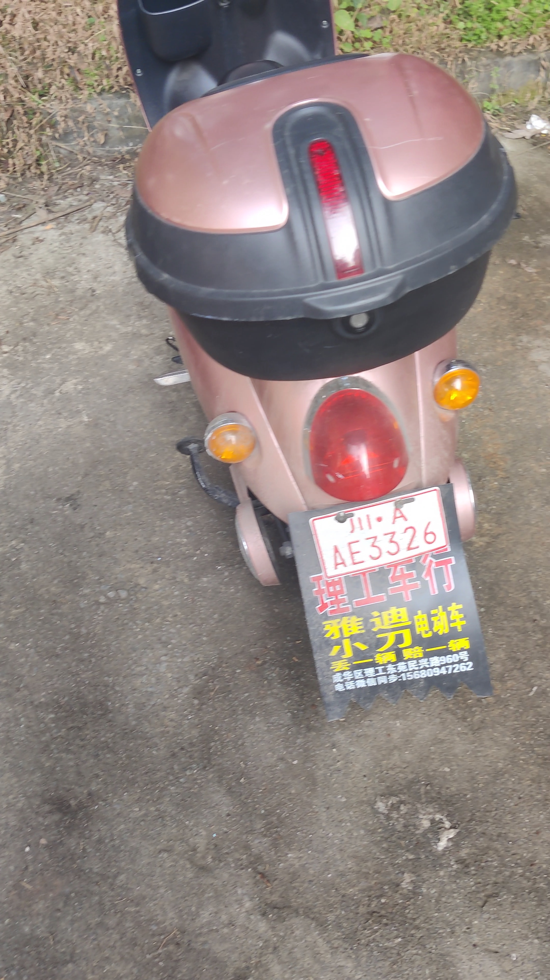
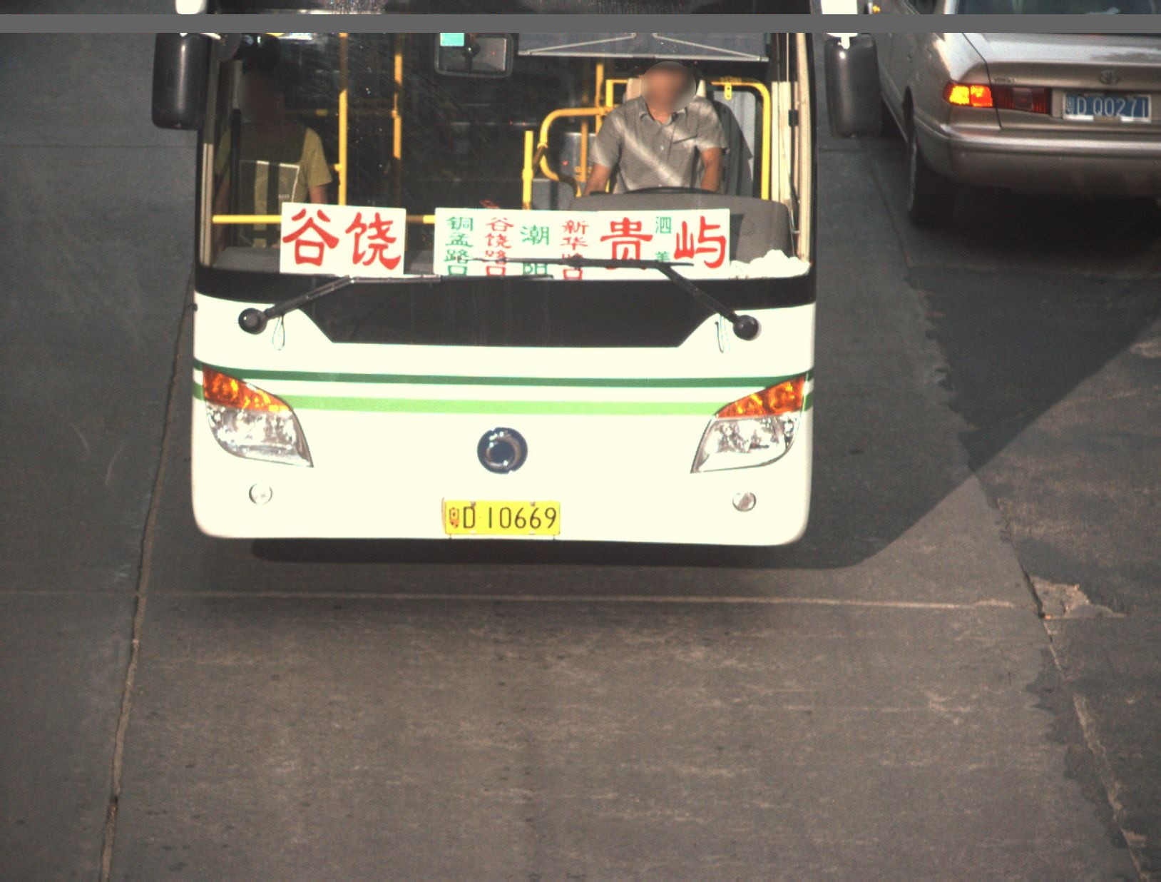
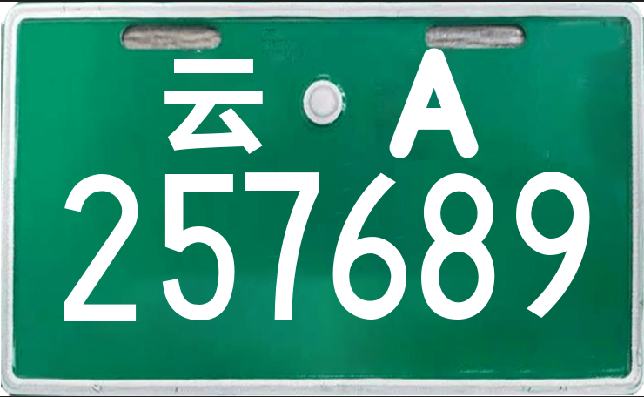
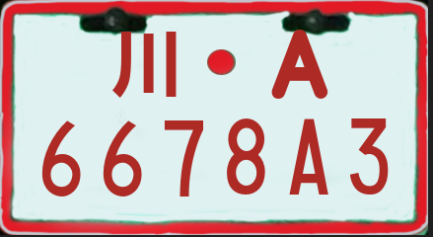
Dataset
Vehicle data set
License Generation
Character
Pictures of vehicles collected through various channels
include both commonly used vehicles and those with
new license plates
Generate license plates for cars, new energy vehicles, trucks, electric
motorcycles in Yunnan, Guizhou, and Sichuan provinces, while also being able to perform data augmentation on the license plates
It consists of the character
picture of the license plate
https://pan.baidu.com/s/1xa6zvOGjU02j8_lqHGVf0A#list/path=%2F
Figure3 Character Dataset
https://aistudio.baidu.com/aistudio/datasetdetail/23617
Figure1 Vehicle Dataset
Figure2 Generated plate

Slide 8
Model
“
”

Slide 9
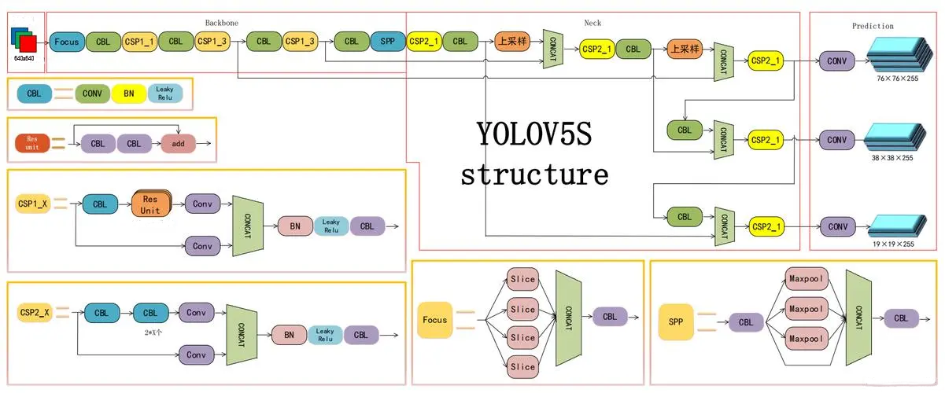
Yolov-5
Yolov5 is a deep learning-based target detection algorithm, which adopts a one-stage detection
method and some new techniques, such as multi-scale training, tag smoothing, etc. These techniques help to improve the detection speed and accuracy of Yolov5. In addition, Yolov5 also introduced a training method based on adaptive data enhancement technology to improve the
robustness of the model.
Figure 4 The Yolov-5 Model

Slide 10
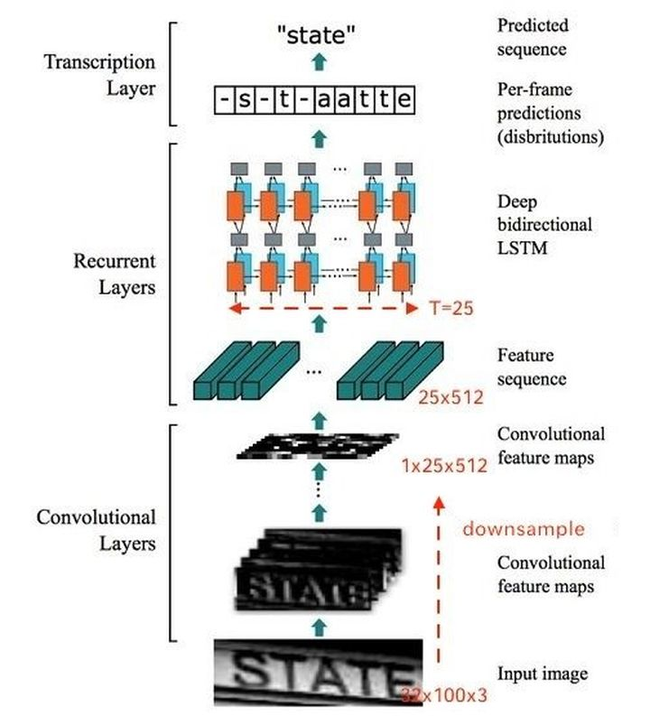
CRNN
It is a deep learning model which combines convolutional neural network (CNN) and cyclic neural network (RNN), and has achieved good results in the field of text recognition and speech recognition. It uses CNN to extract image features, and then uses RNN to model the sequence, so as to realize the processing of long sequence data.
Figure 5 CRNN Model

Slide 11
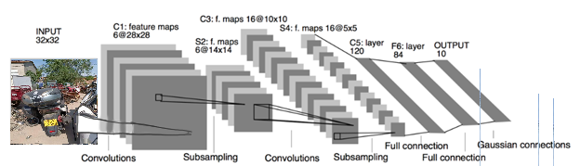
LeNet
LeNet model is a classical convolutional neural network, which is widely used in computer vision tasks, such as digital recognition, face recognition, license plate recognition, image classification and other tasks
Figure 6 LeNet Model

Slide 12
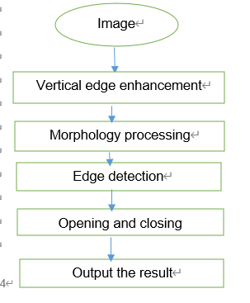
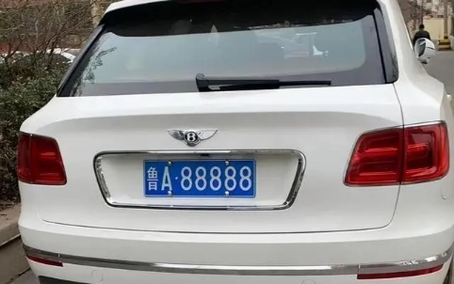


SVM+LeNet
Support Vector Machine: this is a binary classification model, the goal is to find a standard (called hyperplane) to segment the sample data, the principle of segmentation is to ensure the classification optimization.
Figure 6
Figure 7 Split Result
Figure 8 The process of SVM

Slide 13
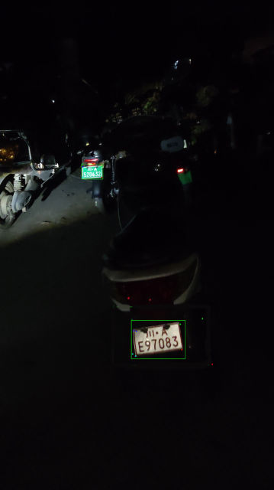
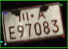
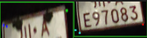
Figure 10 The plate after spliting
Figure 9 Electronic Motorbike plate detection

Slide 14
Result

Slide 15
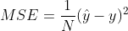
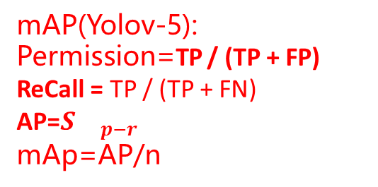
Main evaluation parameter
Accuracy: Accuracy is the ratio of model prediction results to actual results
TP: True Positive TN:True Negative
FP:False Positive FN:False Negative
Accuracy = TP + TN / TP + TN + FP + FN, (Equation 1)
Loss Function:The loss function is a measure of the difference between the predicted results of the model and the actual results
mAP(Yolov-5):
Permission=TP / (TP + FP)
ReCall = TP / (TP + FN)
AP=$S{}_{p−r}$
mAp=AP/n
Equation 2
Equation 3

Slide 16
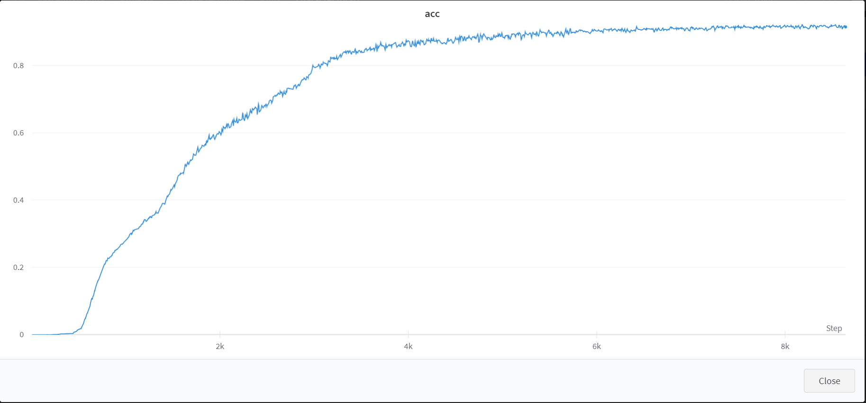
CRNN Accuracy
Total step is 8000, and the accuracy is 92.05%.The result Loss is: 5.69%
Accuracy = TP + TN / TP + TN + FP + FN, (Equation 4)
Figure 10 The Result of Training

Slide 17
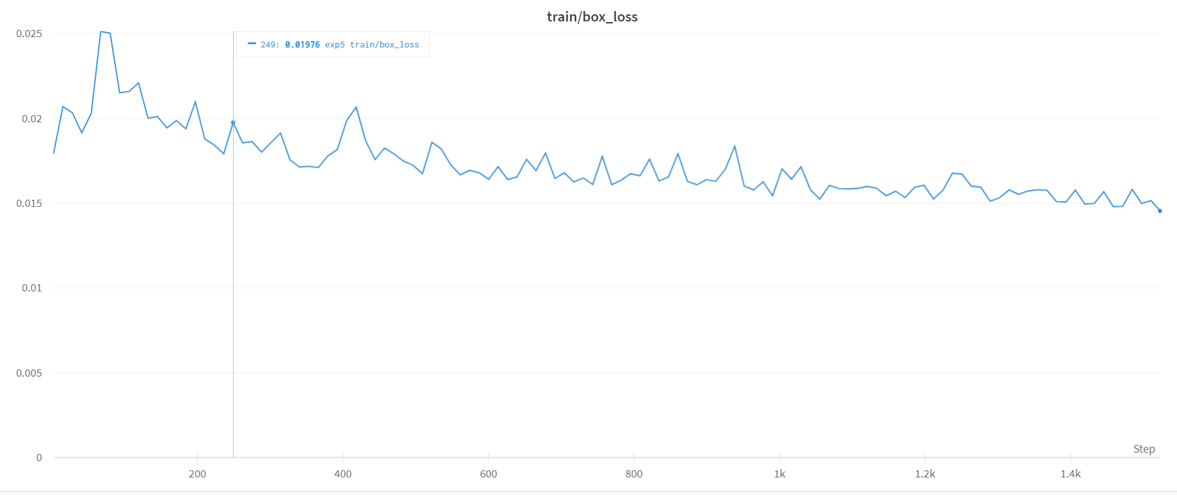
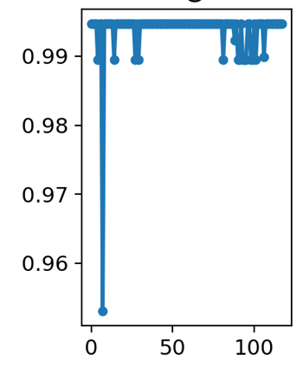
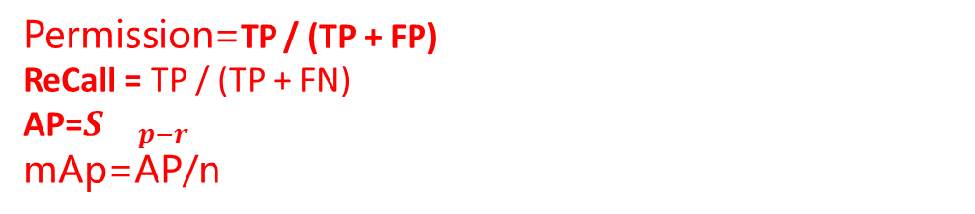
Yolov-5
Loss: 1.46%
Equation 5
mAP:
Figure 11 mAP
Figure 10 The Training Loss of Yolov-5
Permission=TP / (TP + FP)
ReCall = TP / (TP + FN)
AP=$S{}_{p−r}$
mAp=AP/n
Equation 6

Slide 18
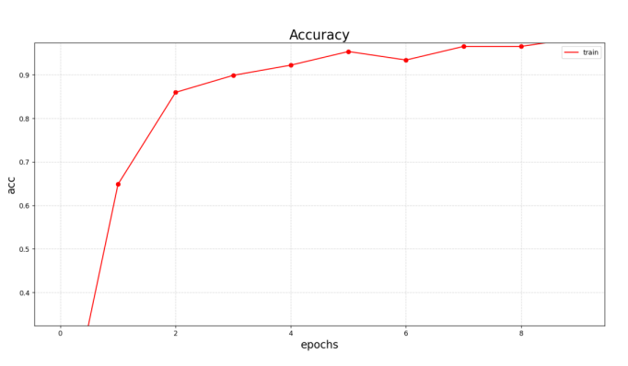
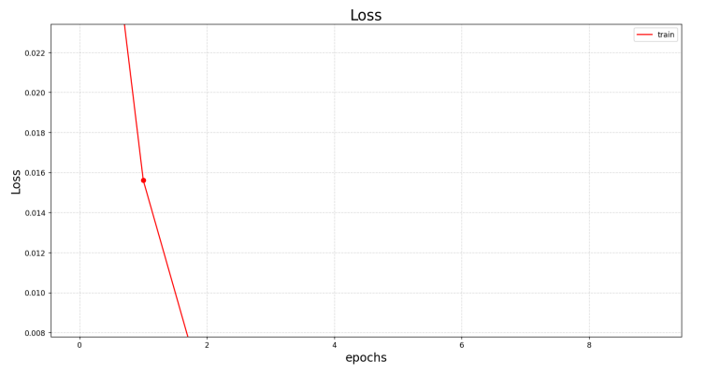
LeNet
Accuracy = 99.06%
Loss = 0.8%
Figure 12： Accuracy Performance of the Model
Figure13： Loss Performance of the Model

Slide 19
GUI

Slide 20
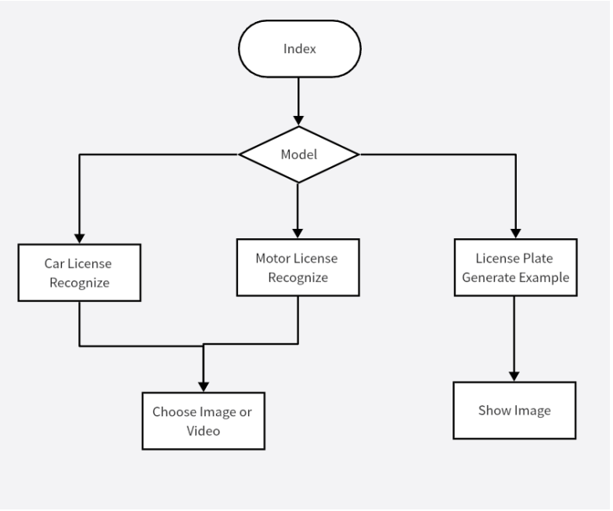
The style of the interface is displayed
Figure 14 UML diagram of GUI

Slide 21

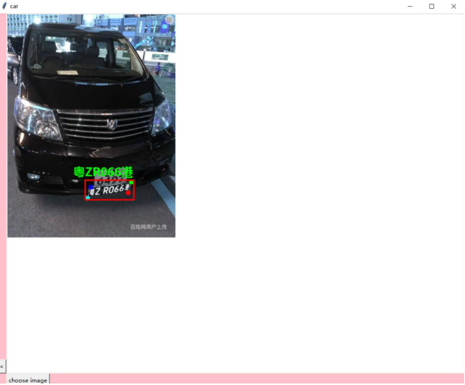
Result presentation
Figure 15
Figure 16

Slide 22
Conclusion
In license plate generation, a license plate can be extracted as a template. After data enhancement, the error is not large. For license plate recognition, LeNet and semantic segmentation are relatively fast, but the accuracy is relatively low, which is suitable for the recognition of small-scale license plate data sets. CRNN and Yolov5 methods are slower but more accurate, which are suitable for the recognition of large-scale license plate data sets. LeNet is a relatively simple convolutional neural network, which is suitable for character recognition tasks and has high speed. However, due to the complexity of license plate characters, the recognition accuracy of LeNet may be low when dealing with relatively complex license plate characters. Semantic segmentation is a kind of segmentation method based on pixel level, which is suitable for the location of license plate area and the speed is relatively fast. However, due to the diversity of shapes and colors of license plates, semantic segmentation may lead to inaccurate license plate location in some cases. CRNN and Yolov5 methods are slow in recognition, but have high accuracy. CRNN is a structure combining convolutional neural network and cyclic neural network, which is suitable for processing sequence data and can recognize license plate characters effectively. Yolov5 is a popular target detection algorithm with high efficiency and accuracy, which is suitable for license plate detection. Both methods have high recognition accuracy and are suitable for large-scale license plate data set recognition tasks.

Slide 23
Future Work
1. Upgrade the training batch and try more parameters
2. Collect license plate information from other places to generate training data sets
3. Data sets are enhanced to accommodate more complex environments

Slide 24
Your Questions are welcome
Thanks for Listening

